Slide 1
Exkurs Arduino Entwicklungsprozess – vom Programmtext zur Ausführung
https://www.arduino.cc

Slide 2
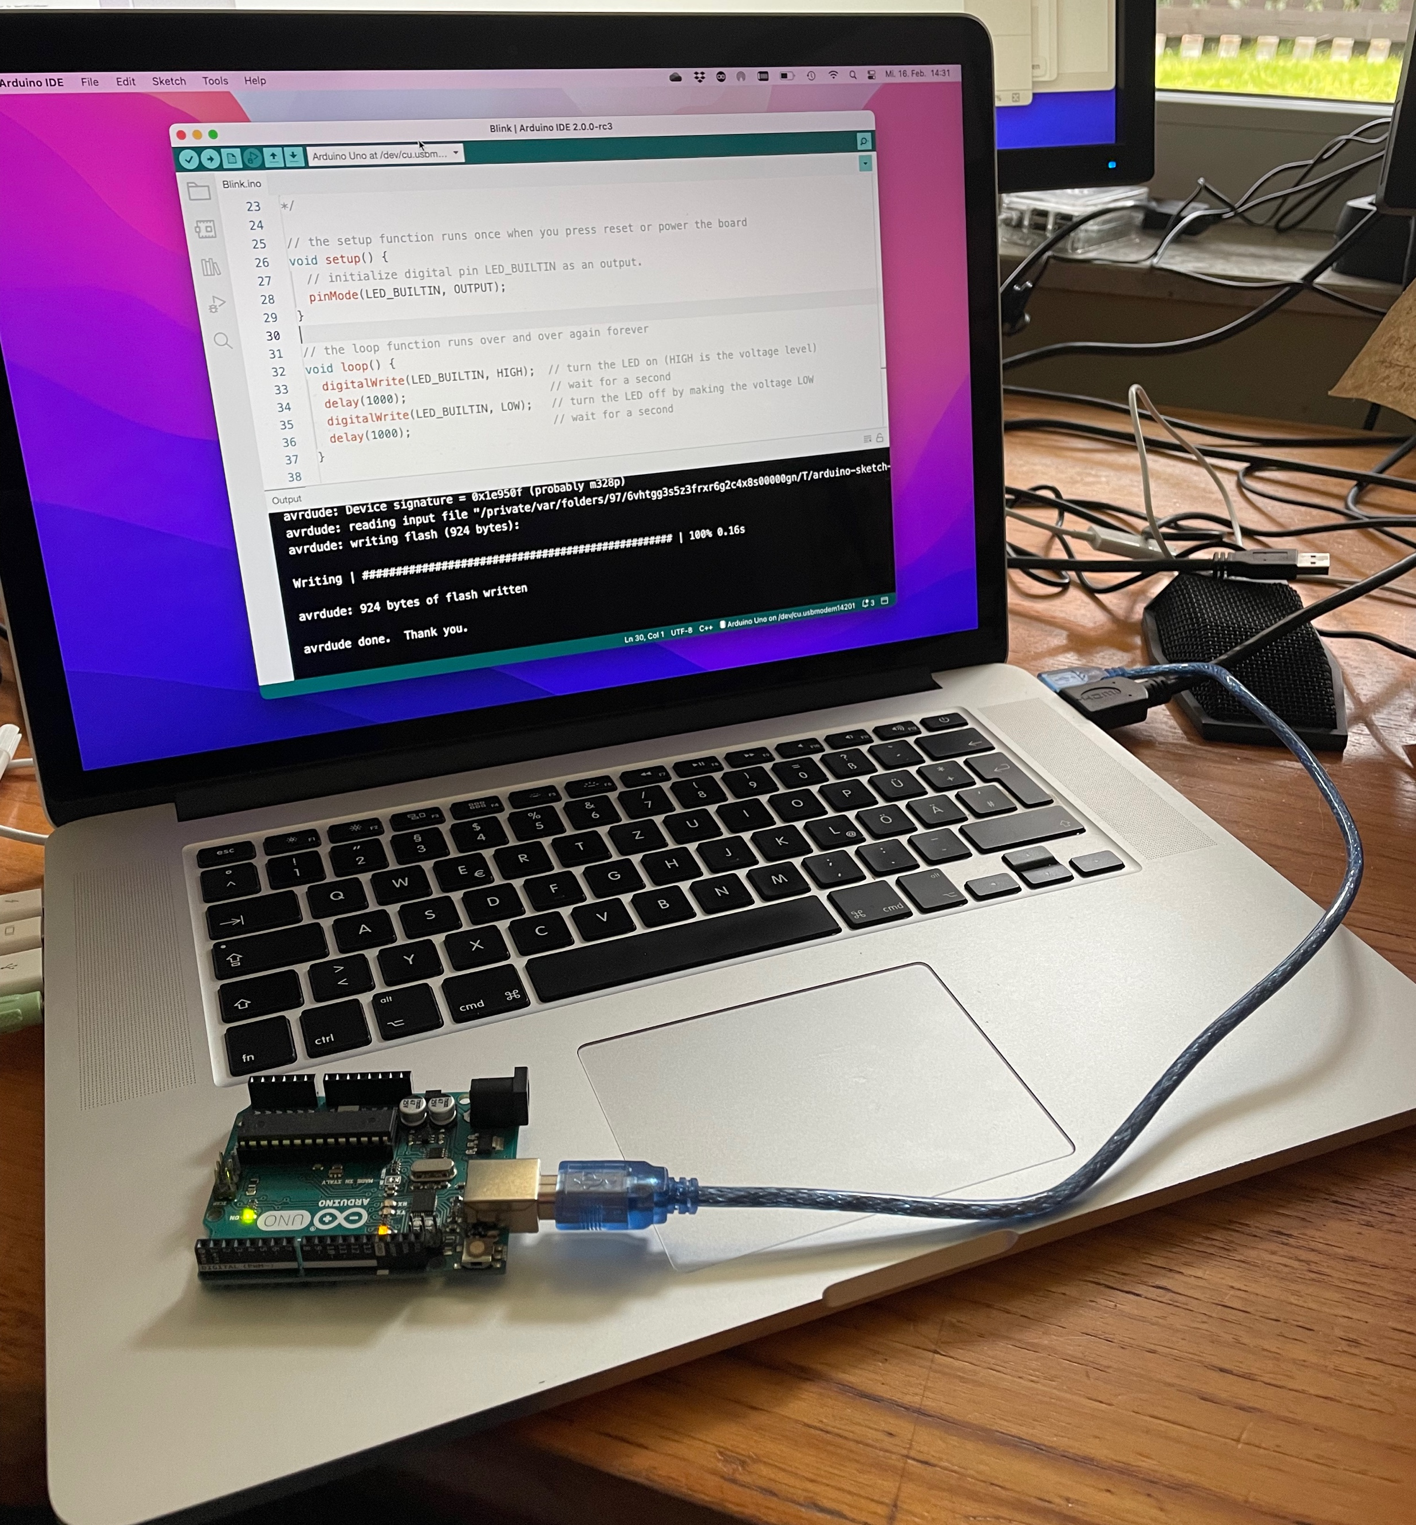

Slide 3
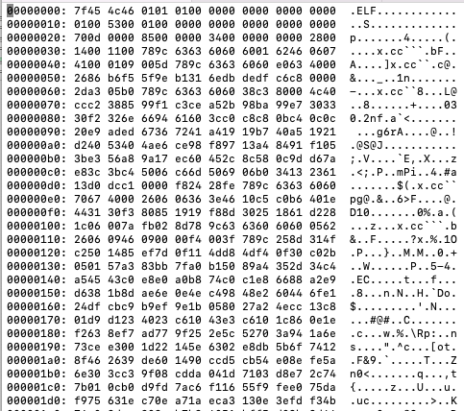
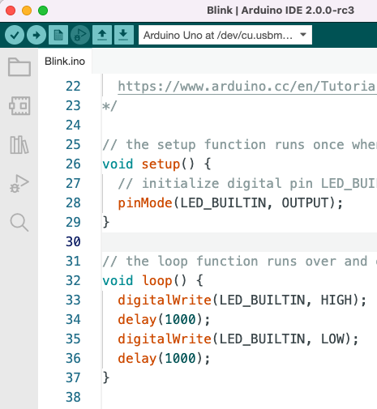
Maschinencode
Objektdatei
Blink.ino.cpp.o
Sketch Programmtext
C++ Source / Quelltext
Blink.ino.cpp
1) Compile
Cross-Compiler avr-g++
Frontend (lexikalische Analyse, Syntaxprüfung, Semantische Analyse)-> Fehlermeldungen
Backend (Zwischencode, Optimierung, Maschinencodegenerierung
Verwendete Bibliotheken
Quelltext
Servo.cpp

Slide 4
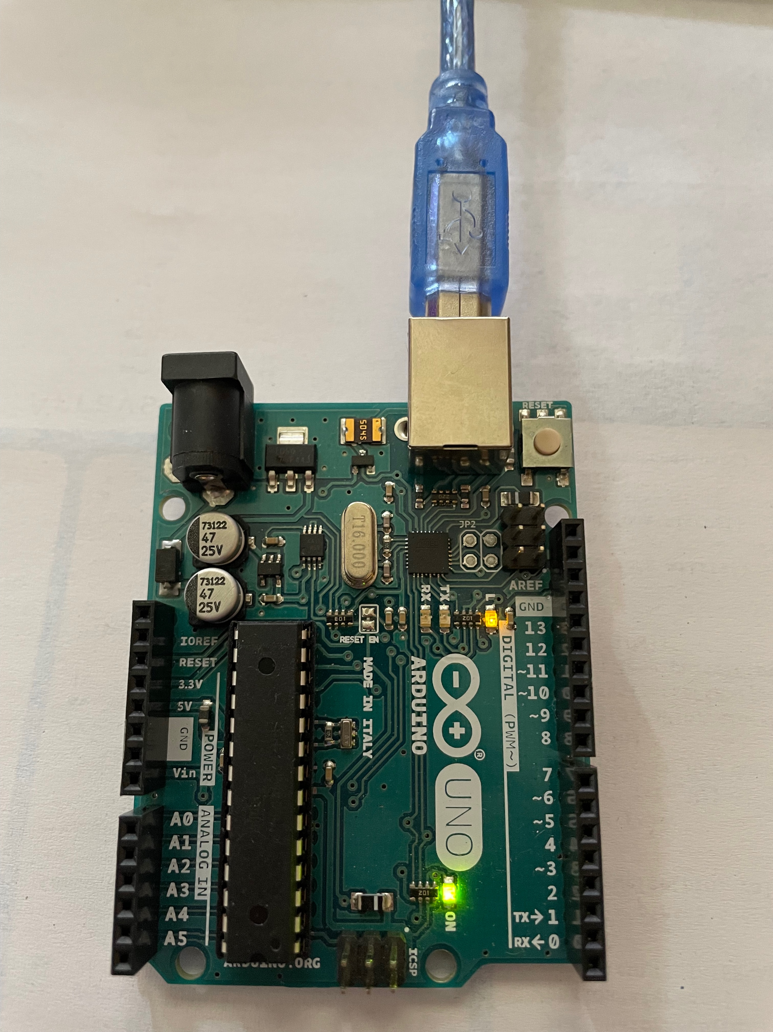
Sketch
Maschinencode
Objektdatei
Blink.ino.cpp.o
Arduino AVR core
Maschinencode
core_arduino_avr_uno_5a92d836b107968b2cfe9bcaf10082b9.a
Sketch
auführbar
Blink.ino.elf
2) Link
Linker
Bindet einzelne Programmteile zu einem ausführbaren Programm
Verwendete Bibliotheken
Maschinencode
Objektdatei
Servo.cpp.o
3) Upload
avrdude
Über serielle Schnittstelle (USB-Adapter) auf Flash Speicher (Bootloader)

Slide 5

Notes:
Do not modify the notes in this section to avoid tampering with the Poll Everywhere activity. More info at polleverywhere.com/support Welche Aussagen zum Build-Process in C/C++ sind korrekt?
https://www.polleverywhere.com/multiple_choice_polls/zAzTuzlIZW7tEMJdxpEEU?display_state=instructions&activity_state=opened&state=opened&flow=Instructor&onscreen=persist

Slide 6

Notes:
Do not modify the notes in this section to avoid tampering with the Poll Everywhere activity. More info at polleverywhere.com/support Welche Aussagen zum Build-Process in C/C++ sind korrekt?
https://www.polleverywhere.com/multiple_choice_polls/zAzTuzlIZW7tEMJdxpEEU?display_state=chart&activity_state=closed&state=closed&flow=Instructor&onscreen=persist

Slide 7
Notes:
Do not modify the notes in this section to avoid tampering with the Poll Everywhere activity. More info at polleverywhere.com/support Welche Aussagen zum Build-Process in C/C++ sind korrekt?
https://www.polleverywhere.com/multiple_choice_polls/zAzTuzlIZW7tEMJdxpEEU?display_state=chart&activity_state=closed&display=correctness&state=closed&flow=Instructor&onscreen=persist

Slide 8
Arduino Entwicklungsumgebung (IDE)
https://www.arduino.cc/en/software
Es gibt die traditionelle (Eclipse) Entwicklungsumgebung (Legacy IDE 1.8.x)
Es gibt die neuere Theia Entwicklungsumgebung (IDE 2.0)
Ich empfehle die neue IDE 2.0.x https://www.arduino.cc/en/software
Unterstützt Debugging mit bestimmten Boards
Autoformatierung, Autocompletion etc.
Gibt es auch als „Cloudversion“ - Webeditor
Beide sind kostenlos und Open source

Slide 9
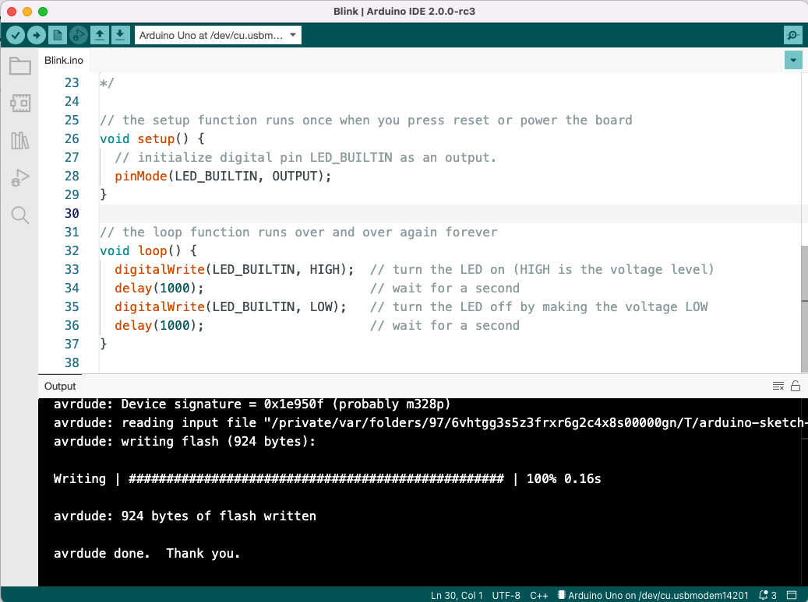

Slide 10
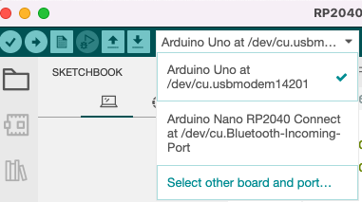
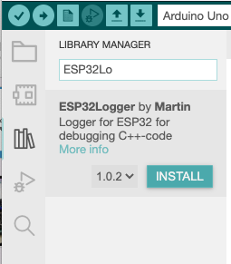
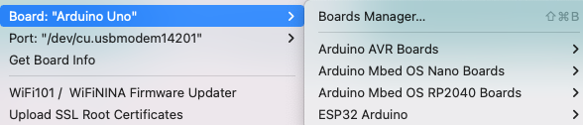
Notwendige Schritte
Board und Port auswählen
Optionale Bibliotheken installieren

Slide 11
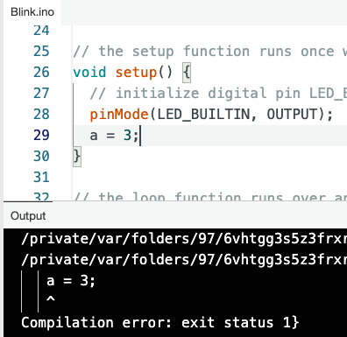

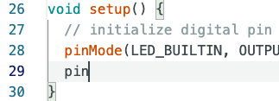
Editor – Programmierunterstützung 1
Autoformatierung (Einrücken)
Validation: Syntaxprüfung
Autovervollständigung

Slide 12
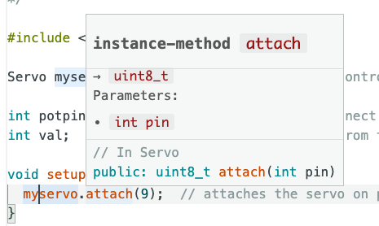
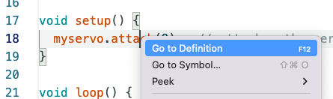
Editor-Programmierunterstützung 2

Slide 13
Attribution und Quellen
Diese Folien wurden von Peter Bendel erstellt.
Für eigene Inhalte gilt die Attribution-ShareAlike 3.0 Unported
Lizenz, https://creativecommons.org/licenses/by-sa/3.0/
Ich habe folgende Quellen verwendet
https://docs.arduino.cc
https://docs.arduino.cc/hardware/uno-rev3

Slide 14
Backup

Slide 15
Using board 'uno' from platform in folder: /Users/peterbendel/Library/Arduino15/packages/arduino/hardware/avr/1.8.4
Using core 'arduino' from platform in folder: /Users/peterbendel/Library/Arduino15/packages/arduino/hardware/avr/1.8.4
Detecting libraries used...
/Users/peterbendel/Library/Arduino15/packages/arduino/tools/avr-gcc/7.3.0-atmel3.6.1-arduino7/bin/avr-g++ -c -g -Os -w -std=gnu++11 -fpermissive -fno-exceptions -ffunction-sections -fdata-sections -fno-threadsafe-statics -Wno-error=narrowing -flto -w -x c++ -E -CC -mmcu=atmega328p -DF_CPU=16000000L -DARDUINO=10607 -DARDUINO_AVR_UNO -DARDUINO_ARCH_AVR -I/Users/peterbendel/Library/Arduino15/packages/arduino/hardware/avr/1.8.4/cores/arduino -I/Users/peterbendel/Library/Arduino15/packages/arduino/hardware/avr/1.8.4/variants/standard /private/var/folders/97/6vhtgg3s5z3frxr6g2c4x8s00000gn/T/arduino-sketch-FAB8513283E49181FAA23F0EF7F61545/sketch/Sweep.ino.cpp -o /dev/null
Alternatives for Servo.h: [Servo@1.1.7 Servo@1.1.8]
ResolveLibrary(Servo.h)
-> candidates: [Servo@1.1.7 Servo@1.1.8]
/Users/peterbendel/Library/Arduino15/packages/arduino/tools/avr-gcc/7.3.0-atmel3.6.1-arduino7/bin/avr-g++ -c -g -Os -w -std=gnu++11 -fpermissive -fno-exceptions -ffunction-sections -fdata-sections -fno-threadsafe-statics -Wno-error=narrowing -flto -w -x c++ -E -CC -mmcu=atmega328p -DF_CPU=16000000L -DARDUINO=10607 -DARDUINO_AVR_UNO -DARDUINO_ARCH_AVR -I/Users/peterbendel/Library/Arduino15/packages/arduino/hardware/avr/1.8.4/cores/arduino -I/Users/peterbendel/Library/Arduino15/packages/arduino/hardware/avr/1.8.4/variants/standard -I/Users/peterbendel/Documents/Arduino/libraries/Servo/src /private/var/folders/97/6vhtgg3s5z3frxr6g2c4x8s00000gn/T/arduino-sketch-FAB8513283E49181FAA23F0EF7F61545/sketch/Sweep.ino.cpp -o /dev/null
/Users/peterbendel/Library/Arduino15/packages/arduino/tools/avr-gcc/7.3.0-atmel3.6.1-arduino7/bin/avr-g++ -c -g -Os -w -std=gnu++11 -fpermissive -fno-exceptions -ffunction-sections -fdata-sections -fno-threadsafe-statics -Wno-error=narrowing -flto -w -x c++ -E -CC -mmcu=atmega328p -DF_CPU=16000000L -DARDUINO=10607 -DARDUINO_AVR_UNO -DARDUINO_ARCH_AVR -I/Users/peterbendel/Library/Arduino15/packages/arduino/hardware/avr/1.8.4/cores/arduino -I/Users/peterbendel/Library/Arduino15/packages/arduino/hardware/avr/1.8.4/variants/standard -I/Users/peterbendel/Documents/Arduino/libraries/Servo/src /Users/peterbendel/Documents/Arduino/libraries/Servo/src/avr/Servo.cpp -o /dev/null
/Users/peterbendel/Library/Arduino15/packages/arduino/tools/avr-gcc/7.3.0-atmel3.6.1-arduino7/bin/avr-g++ -c -g -Os -w -std=gnu++11 -fpermissive -fno-exceptions -ffunction-sections -fdata-sections -fno-threadsafe-statics -Wno-error=narrowing -flto -w -x c++ -E -CC -mmcu=atmega328p -DF_CPU=16000000L -DARDUINO=10607 -DARDUINO_AVR_UNO -DARDUINO_ARCH_AVR -I/Users/peterbendel/Library/Arduino15/packages/arduino/hardware/avr/1.8.4/cores/arduino -I/Users/peterbendel/Library/Arduino15/packages/arduino/hardware/avr/1.8.4/variants/standard -I/Users/peterbendel/Documents/Arduino/libraries/Servo/src /Users/peterbendel/Documents/Arduino/libraries/Servo/src/mbed/Servo.cpp -o /dev/null
/Users/peterbendel/Library/Arduino15/packages/arduino/tools/avr-gcc/7.3.0-atmel3.6.1-arduino7/bin/avr-g++ -c -g -Os -w -std=gnu++11 -fpermissive -fno-exceptions -ffunction-sections -fdata-sections -fno-threadsafe-statics -Wno-error=narrowing -flto -w -x c++ -E -CC -mmcu=atmega328p -DF_CPU=16000000L -DARDUINO=10607 -DARDUINO_AVR_UNO -DARDUINO_ARCH_AVR -I/Users/peterbendel/Library/Arduino15/packages/arduino/hardware/avr/1.8.4/cores/arduino -I/Users/peterbendel/Library/Arduino15/packages/arduino/hardware/avr/1.8.4/variants/standard -I/Users/peterbendel/Documents/Arduino/libraries/Servo/src /Users/peterbendel/Documents/Arduino/libraries/Servo/src/megaavr/Servo.cpp -o /dev/null
/Users/peterbendel/Library/Arduino15/packages/arduino/tools/avr-gcc/7.3.0-atmel3.6.1-arduino7/bin/avr-g++ -c -g -Os -w -std=gnu++11 -fpermissive -fno-exceptions -ffunction-sections -fdata-sections -fno-threadsafe-statics -Wno-error=narrowing -flto -w -x c++ -E -CC -mmcu=atmega328p -DF_CPU=16000000L -DARDUINO=10607 -DARDUINO_AVR_UNO -DARDUINO_ARCH_AVR -I/Users/peterbendel/Library/Arduino15/packages/arduino/hardware/avr/1.8.4/cores/arduino -I/Users/peterbendel/Library/Arduino15/packages/arduino/hardware/avr/1.8.4/variants/standard -I/Users/peterbendel/Documents/Arduino/libraries/Servo/src /Users/peterbendel/Documents/Arduino/libraries/Servo/src/nrf52/Servo.cpp -o /dev/null
/Users/peterbendel/Library/Arduino15/packages/arduino/tools/avr-gcc/7.3.0-atmel3.6.1-arduino7/bin/avr-g++ -c -g -Os -w -std=gnu++11 -fpermissive -fno-exceptions -ffunction-sections -fdata-sections -fno-threadsafe-statics -Wno-error=narrowing -flto -w -x c++ -E -CC -mmcu=atmega328p -DF_CPU=16000000L -DARDUINO=10607 -DARDUINO_AVR_UNO -DARDUINO_ARCH_AVR -I/Users/peterbendel/Library/Arduino15/packages/arduino/hardware/avr/1.8.4/cores/arduino -I/Users/peterbendel/Library/Arduino15/packages/arduino/hardware/avr/1.8.4/variants/standard -I/Users/peterbendel/Documents/Arduino/libraries/Servo/src /Users/peterbendel/Documents/Arduino/libraries/Servo/src/sam/Servo.cpp -o /dev/null
/Users/peterbendel/Library/Arduino15/packages/arduino/tools/avr-gcc/7.3.0-atmel3.6.1-arduino7/bin/avr-g++ -c -g -Os -w -std=gnu++11 -fpermissive -fno-exceptions -ffunction-sections -fdata-sections -fno-threadsafe-statics -Wno-error=narrowing -flto -w -x c++ -E -CC -mmcu=atmega328p -DF_CPU=16000000L -DARDUINO=10607 -DARDUINO_AVR_UNO -DARDUINO_ARCH_AVR -I/Users/peterbendel/Library/Arduino15/packages/arduino/hardware/avr/1.8.4/cores/arduino -I/Users/peterbendel/Library/Arduino15/packages/arduino/hardware/avr/1.8.4/variants/standard -I/Users/peterbendel/Documents/Arduino/libraries/Servo/src /Users/peterbendel/Documents/Arduino/libraries/Servo/src/samd/Servo.cpp -o /dev/null
/Users/peterbendel/Library/Arduino15/packages/arduino/tools/avr-gcc/7.3.0-atmel3.6.1-arduino7/bin/avr-g++ -c -g -Os -w -std=gnu++11 -fpermissive -fno-exceptions -ffunction-sections -fdata-sections -fno-threadsafe-statics -Wno-error=narrowing -flto -w -x c++ -E -CC -mmcu=atmega328p -DF_CPU=16000000L -DARDUINO=10607 -DARDUINO_AVR_UNO -DARDUINO_ARCH_AVR -I/Users/peterbendel/Library/Arduino15/packages/arduino/hardware/avr/1.8.4/cores/arduino -I/Users/peterbendel/Library/Arduino15/packages/arduino/hardware/avr/1.8.4/variants/standard -I/Users/peterbendel/Documents/Arduino/libraries/Servo/src /Users/peterbendel/Documents/Arduino/libraries/Servo/src/stm32f4/Servo.cpp -o /dev/null
Generating function prototypes...
Notes:
Using board 'uno' from platform in folder: /Users/peterbendel/Library/Arduino15/packages/arduino/hardware/avr/1.8.4
Using core 'arduino' from platform in folder: /Users/peterbendel/Library/Arduino15/packages/arduino/hardware/avr/1.8.4
Detecting libraries used...
/Users/peterbendel/Library/Arduino15/packages/arduino/tools/avr-gcc/7.3.0-atmel3.6.1-arduino7/bin/avr-g++ -c -g -Os -w -std=gnu++11 -fpermissive -fno-exceptions -ffunction-sections -fdata-sections -fno-threadsafe-statics -Wno-error=narrowing -flto -w -x c++ -E -CC -mmcu=atmega328p -DF_CPU=16000000L -DARDUINO=10607 -DARDUINO_AVR_UNO -DARDUINO_ARCH_AVR -I/Users/peterbendel/Library/Arduino15/packages/arduino/hardware/avr/1.8.4/cores/arduino -I/Users/peterbendel/Library/Arduino15/packages/arduino/hardware/avr/1.8.4/variants/standard /private/var/folders/97/6vhtgg3s5z3frxr6g2c4x8s00000gn/T/arduino-sketch-FAB8513283E49181FAA23F0EF7F61545/sketch/Sweep.ino.cpp -o /dev/null
Alternatives for Servo.h: [Servo@1.1.7 Servo@1.1.8]
ResolveLibrary(Servo.h)
-> candidates: [Servo@1.1.7 Servo@1.1.8]
/Users/peterbendel/Library/Arduino15/packages/arduino/tools/avr-gcc/7.3.0-atmel3.6.1-arduino7/bin/avr-g++ -c -g -Os -w -std=gnu++11 -fpermissive -fno-exceptions -ffunction-sections -fdata-sections -fno-threadsafe-statics -Wno-error=narrowing -flto -w -x c++ -E -CC -mmcu=atmega328p -DF_CPU=16000000L -DARDUINO=10607 -DARDUINO_AVR_UNO -DARDUINO_ARCH_AVR -I/Users/peterbendel/Library/Arduino15/packages/arduino/hardware/avr/1.8.4/cores/arduino -I/Users/peterbendel/Library/Arduino15/packages/arduino/hardware/avr/1.8.4/variants/standard -I/Users/peterbendel/Documents/Arduino/libraries/Servo/src /private/var/folders/97/6vhtgg3s5z3frxr6g2c4x8s00000gn/T/arduino-sketch-FAB8513283E49181FAA23F0EF7F61545/sketch/Sweep.ino.cpp -o /dev/null
/Users/peterbendel/Library/Arduino15/packages/arduino/tools/avr-gcc/7.3.0-atmel3.6.1-arduino7/bin/avr-g++ -c -g -Os -w -std=gnu++11 -fpermissive -fno-exceptions -ffunction-sections -fdata-sections -fno-threadsafe-statics -Wno-error=narrowing -flto -w -x c++ -E -CC -mmcu=atmega328p -DF_CPU=16000000L -DARDUINO=10607 -DARDUINO_AVR_UNO -DARDUINO_ARCH_AVR -I/Users/peterbendel/Library/Arduino15/packages/arduino/hardware/avr/1.8.4/cores/arduino -I/Users/peterbendel/Library/Arduino15/packages/arduino/hardware/avr/1.8.4/variants/standard -I/Users/peterbendel/Documents/Arduino/libraries/Servo/src /Users/peterbendel/Documents/Arduino/libraries/Servo/src/avr/Servo.cpp -o /dev/null
/Users/peterbendel/Library/Arduino15/packages/arduino/tools/avr-gcc/7.3.0-atmel3.6.1-arduino7/bin/avr-g++ -c -g -Os -w -std=gnu++11 -fpermissive -fno-exceptions -ffunction-sections -fdata-sections -fno-threadsafe-statics -Wno-error=narrowing -flto -w -x c++ -E -CC -mmcu=atmega328p -DF_CPU=16000000L -DARDUINO=10607 -DARDUINO_AVR_UNO -DARDUINO_ARCH_AVR -I/Users/peterbendel/Library/Arduino15/packages/arduino/hardware/avr/1.8.4/cores/arduino -I/Users/peterbendel/Library/Arduino15/packages/arduino/hardware/avr/1.8.4/variants/standard -I/Users/peterbendel/Documents/Arduino/libraries/Servo/src /Users/peterbendel/Documents/Arduino/libraries/Servo/src/mbed/Servo.cpp -o /dev/null
/Users/peterbendel/Library/Arduino15/packages/arduino/tools/avr-gcc/7.3.0-atmel3.6.1-arduino7/bin/avr-g++ -c -g -Os -w -std=gnu++11 -fpermissive -fno-exceptions -ffunction-sections -fdata-sections -fno-threadsafe-statics -Wno-error=narrowing -flto -w -x c++ -E -CC -mmcu=atmega328p -DF_CPU=16000000L -DARDUINO=10607 -DARDUINO_AVR_UNO -DARDUINO_ARCH_AVR -I/Users/peterbendel/Library/Arduino15/packages/arduino/hardware/avr/1.8.4/cores/arduino -I/Users/peterbendel/Library/Arduino15/packages/arduino/hardware/avr/1.8.4/variants/standard -I/Users/peterbendel/Documents/Arduino/libraries/Servo/src /Users/peterbendel/Documents/Arduino/libraries/Servo/src/megaavr/Servo.cpp -o /dev/null
/Users/peterbendel/Library/Arduino15/packages/arduino/tools/avr-gcc/7.3.0-atmel3.6.1-arduino7/bin/avr-g++ -c -g -Os -w -std=gnu++11 -fpermissive -fno-exceptions -ffunction-sections -fdata-sections -fno-threadsafe-statics -Wno-error=narrowing -flto -w -x c++ -E -CC -mmcu=atmega328p -DF_CPU=16000000L -DARDUINO=10607 -DARDUINO_AVR_UNO -DARDUINO_ARCH_AVR -I/Users/peterbendel/Library/Arduino15/packages/arduino/hardware/avr/1.8.4/cores/arduino -I/Users/peterbendel/Library/Arduino15/packages/arduino/hardware/avr/1.8.4/variants/standard -I/Users/peterbendel/Documents/Arduino/libraries/Servo/src /Users/peterbendel/Documents/Arduino/libraries/Servo/src/nrf52/Servo.cpp -o /dev/null
/Users/peterbendel/Library/Arduino15/packages/arduino/tools/avr-gcc/7.3.0-atmel3.6.1-arduino7/bin/avr-g++ -c -g -Os -w -std=gnu++11 -fpermissive -fno-exceptions -ffunction-sections -fdata-sections -fno-threadsafe-statics -Wno-error=narrowing -flto -w -x c++ -E -CC -mmcu=atmega328p -DF_CPU=16000000L -DARDUINO=10607 -DARDUINO_AVR_UNO -DARDUINO_ARCH_AVR -I/Users/peterbendel/Library/Arduino15/packages/arduino/hardware/avr/1.8.4/cores/arduino -I/Users/peterbendel/Library/Arduino15/packages/arduino/hardware/avr/1.8.4/variants/standard -I/Users/peterbendel/Documents/Arduino/libraries/Servo/src /Users/peterbendel/Documents/Arduino/libraries/Servo/src/sam/Servo.cpp -o /dev/null
/Users/peterbendel/Library/Arduino15/packages/arduino/tools/avr-gcc/7.3.0-atmel3.6.1-arduino7/bin/avr-g++ -c -g -Os -w -std=gnu++11 -fpermissive -fno-exceptions -ffunction-sections -fdata-sections -fno-threadsafe-statics -Wno-error=narrowing -flto -w -x c++ -E -CC -mmcu=atmega328p -DF_CPU=16000000L -DARDUINO=10607 -DARDUINO_AVR_UNO -DARDUINO_ARCH_AVR -I/Users/peterbendel/Library/Arduino15/packages/arduino/hardware/avr/1.8.4/cores/arduino -I/Users/peterbendel/Library/Arduino15/packages/arduino/hardware/avr/1.8.4/variants/standard -I/Users/peterbendel/Documents/Arduino/libraries/Servo/src /Users/peterbendel/Documents/Arduino/libraries/Servo/src/samd/Servo.cpp -o /dev/null
/Users/peterbendel/Library/Arduino15/packages/arduino/tools/avr-gcc/7.3.0-atmel3.6.1-arduino7/bin/avr-g++ -c -g -Os -w -std=gnu++11 -fpermissive -fno-exceptions -ffunction-sections -fdata-sections -fno-threadsafe-statics -Wno-error=narrowing -flto -w -x c++ -E -CC -mmcu=atmega328p -DF_CPU=16000000L -DARDUINO=10607 -DARDUINO_AVR_UNO -DARDUINO_ARCH_AVR -I/Users/peterbendel/Library/Arduino15/packages/arduino/hardware/avr/1.8.4/cores/arduino -I/Users/peterbendel/Library/Arduino15/packages/arduino/hardware/avr/1.8.4/variants/standard -I/Users/peterbendel/Documents/Arduino/libraries/Servo/src /Users/peterbendel/Documents/Arduino/libraries/Servo/src/stm32f4/Servo.cpp -o /dev/null
Generating function prototypes...
/Users/peterbendel/Library/Arduino15/packages/arduino/tools/avr-gcc/7.3.0-atmel3.6.1-arduino7/bin/avr-g++ -c -g -Os -w -std=gnu++11 -fpermissive -fno-exceptions -ffunction-sections -fdata-sections -fno-threadsafe-statics -Wno-error=narrowing -flto -w -x c++ -E -CC -mmcu=atmega328p -DF_CPU=16000000L -DARDUINO=10607 -DARDUINO_AVR_UNO -DARDUINO_ARCH_AVR -I/Users/peterbendel/Library/Arduino15/packages/arduino/hardware/avr/1.8.4/cores/arduino -I/Users/peterbendel/Library/Arduino15/packages/arduino/hardware/avr/1.8.4/variants/standard -I/Users/peterbendel/Documents/Arduino/libraries/Servo/src /private/var/folders/97/6vhtgg3s5z3frxr6g2c4x8s00000gn/T/arduino-sketch-FAB8513283E49181FAA23F0EF7F61545/sketch/Sweep.ino.cpp -o /private/var/folders/97/6vhtgg3s5z3frxr6g2c4x8s00000gn/T/arduino-sketch-FAB8513283E49181FAA23F0EF7F61545/preproc/ctags_target_for_gcc_minus_e.cpp
/Users/peterbendel/Library/Arduino15/packages/builtin/tools/ctags/5.8-arduino11/ctags -u --language-force=c++ -f - --c++-kinds=svpf --fields=KSTtzns --line-directives /private/var/folders/97/6vhtgg3s5z3frxr6g2c4x8s00000gn/T/arduino-sketch-FAB8513283E49181FAA23F0EF7F61545/preproc/ctags_target_for_gcc_minus_e.cpp
Compiling sketch...
/Users/peterbendel/Library/Arduino15/packages/arduino/tools/avr-gcc/7.3.0-atmel3.6.1-arduino7/bin/avr-g++ -c -g -Os -w -std=gnu++11 -fpermissive -fno-exceptions -ffunction-sections -fdata-sections -fno-threadsafe-statics -Wno-error=narrowing -MMD -flto -mmcu=atmega328p -DF_CPU=16000000L -DARDUINO=10607 -DARDUINO_AVR_UNO -DARDUINO_ARCH_AVR -I/Users/peterbendel/Library/Arduino15/packages/arduino/hardware/avr/1.8.4/cores/arduino -I/Users/peterbendel/Library/Arduino15/packages/arduino/hardware/avr/1.8.4/variants/standard -I/Users/peterbendel/Documents/Arduino/libraries/Servo/src /private/var/folders/97/6vhtgg3s5z3frxr6g2c4x8s00000gn/T/arduino-sketch-FAB8513283E49181FAA23F0EF7F61545/sketch/Sweep.ino.cpp -o /private/var/folders/97/6vhtgg3s5z3frxr6g2c4x8s00000gn/T/arduino-sketch-FAB8513283E49181FAA23F0EF7F61545/sketch/Sweep.ino.cpp.o
Compiling libraries...
Compiling library "Servo"
/Users/peterbendel/Library/Arduino15/packages/arduino/tools/avr-gcc/7.3.0-atmel3.6.1-arduino7/bin/avr-g++ -c -g -Os -w -std=gnu++11 -fpermissive -fno-exceptions -ffunction-sections -fdata-sections -fno-threadsafe-statics -Wno-error=narrowing -MMD -flto -mmcu=atmega328p -DF_CPU=16000000L -DARDUINO=10607 -DARDUINO_AVR_UNO -DARDUINO_ARCH_AVR -I/Users/peterbendel/Library/Arduino15/packages/arduino/hardware/avr/1.8.4/cores/arduino -I/Users/peterbendel/Library/Arduino15/packages/arduino/hardware/avr/1.8.4/variants/standard -I/Users/peterbendel/Documents/Arduino/libraries/Servo/src /Users/peterbendel/Documents/Arduino/libraries/Servo/src/avr/Servo.cpp -o /private/var/folders/97/6vhtgg3s5z3frxr6g2c4x8s00000gn/T/arduino-sketch-FAB8513283E49181FAA23F0EF7F61545/libraries/Servo/avr/Servo.cpp.o
/Users/peterbendel/Library/Arduino15/packages/arduino/tools/avr-gcc/7.3.0-atmel3.6.1-arduino7/bin/avr-g++ -c -g -Os -w -std=gnu++11 -fpermissive -fno-exceptions -ffunction-sections -fdata-sections -fno-threadsafe-statics -Wno-error=narrowing -MMD -flto -mmcu=atmega328p -DF_CPU=16000000L -DARDUINO=10607 -DARDUINO_AVR_UNO -DARDUINO_ARCH_AVR -I/Users/peterbendel/Library/Arduino15/packages/arduino/hardware/avr/1.8.4/cores/arduino -I/Users/peterbendel/Library/Arduino15/packages/arduino/hardware/avr/1.8.4/variants/standard -I/Users/peterbendel/Documents/Arduino/libraries/Servo/src /Users/peterbendel/Documents/Arduino/libraries/Servo/src/mbed/Servo.cpp -o /private/var/folders/97/6vhtgg3s5z3frxr6g2c4x8s00000gn/T/arduino-sketch-FAB8513283E49181FAA23F0EF7F61545/libraries/Servo/mbed/Servo.cpp.o
/Users/peterbendel/Library/Arduino15/packages/arduino/tools/avr-gcc/7.3.0-atmel3.6.1-arduino7/bin/avr-g++ -c -g -Os -w -std=gnu++11 -fpermissive -fno-exceptions -ffunction-sections -fdata-sections -fno-threadsafe-statics -Wno-error=narrowing -MMD -flto -mmcu=atmega328p -DF_CPU=16000000L -DARDUINO=10607 -DARDUINO_AVR_UNO -DARDUINO_ARCH_AVR -I/Users/peterbendel/Library/Arduino15/packages/arduino/hardware/avr/1.8.4/cores/arduino -I/Users/peterbendel/Library/Arduino15/packages/arduino/hardware/avr/1.8.4/variants/standard -I/Users/peterbendel/Documents/Arduino/libraries/Servo/src /Users/peterbendel/Documents/Arduino/libraries/Servo/src/megaavr/Servo.cpp -o /private/var/folders/97/6vhtgg3s5z3frxr6g2c4x8s00000gn/T/arduino-sketch-FAB8513283E49181FAA23F0EF7F61545/libraries/Servo/megaavr/Servo.cpp.o
/Users/peterbendel/Library/Arduino15/packages/arduino/tools/avr-gcc/7.3.0-atmel3.6.1-arduino7/bin/avr-g++ -c -g -Os -w -std=gnu++11 -fpermissive -fno-exceptions -ffunction-sections -fdata-sections -fno-threadsafe-statics -Wno-error=narrowing -MMD -flto -mmcu=atmega328p -DF_CPU=16000000L -DARDUINO=10607 -DARDUINO_AVR_UNO -DARDUINO_ARCH_AVR -I/Users/peterbendel/Library/Arduino15/packages/arduino/hardware/avr/1.8.4/cores/arduino -I/Users/peterbendel/Library/Arduino15/packages/arduino/hardware/avr/1.8.4/variants/standard -I/Users/peterbendel/Documents/Arduino/libraries/Servo/src /Users/peterbendel/Documents/Arduino/libraries/Servo/src/nrf52/Servo.cpp -o /private/var/folders/97/6vhtgg3s5z3frxr6g2c4x8s00000gn/T/arduino-sketch-FAB8513283E49181FAA23F0EF7F61545/libraries/Servo/nrf52/Servo.cpp.o
/Users/peterbendel/Library/Arduino15/packages/arduino/tools/avr-gcc/7.3.0-atmel3.6.1-arduino7/bin/avr-g++ -c -g -Os -w -std=gnu++11 -fpermissive -fno-exceptions -ffunction-sections -fdata-sections -fno-threadsafe-statics -Wno-error=narrowing -MMD -flto -mmcu=atmega328p -DF_CPU=16000000L -DARDUINO=10607 -DARDUINO_AVR_UNO -DARDUINO_ARCH_AVR -I/Users/peterbendel/Library/Arduino15/packages/arduino/hardware/avr/1.8.4/cores/arduino -I/Users/peterbendel/Library/Arduino15/packages/arduino/hardware/avr/1.8.4/variants/standard -I/Users/peterbendel/Documents/Arduino/libraries/Servo/src /Users/peterbendel/Documents/Arduino/libraries/Servo/src/sam/Servo.cpp -o /private/var/folders/97/6vhtgg3s5z3frxr6g2c4x8s00000gn/T/arduino-sketch-FAB8513283E49181FAA23F0EF7F61545/libraries/Servo/sam/Servo.cpp.o
/Users/peterbendel/Library/Arduino15/packages/arduino/tools/avr-gcc/7.3.0-atmel3.6.1-arduino7/bin/avr-g++ -c -g -Os -w -std=gnu++11 -fpermissive -fno-exceptions -ffunction-sections -fdata-sections -fno-threadsafe-statics -Wno-error=narrowing -MMD -flto -mmcu=atmega328p -DF_CPU=16000000L -DARDUINO=10607 -DARDUINO_AVR_UNO -DARDUINO_ARCH_AVR -I/Users/peterbendel/Library/Arduino15/packages/arduino/hardware/avr/1.8.4/cores/arduino -I/Users/peterbendel/Library/Arduino15/packages/arduino/hardware/avr/1.8.4/variants/standard -I/Users/peterbendel/Documents/Arduino/libraries/Servo/src /Users/peterbendel/Documents/Arduino/libraries/Servo/src/samd/Servo.cpp -o /private/var/folders/97/6vhtgg3s5z3frxr6g2c4x8s00000gn/T/arduino-sketch-FAB8513283E49181FAA23F0EF7F61545/libraries/Servo/samd/Servo.cpp.o
/Users/peterbendel/Library/Arduino15/packages/arduino/tools/avr-gcc/7.3.0-atmel3.6.1-arduino7/bin/avr-g++ -c -g -Os -w -std=gnu++11 -fpermissive -fno-exceptions -ffunction-sections -fdata-sections -fno-threadsafe-statics -Wno-error=narrowing -MMD -flto -mmcu=atmega328p -DF_CPU=16000000L -DARDUINO=10607 -DARDUINO_AVR_UNO -DARDUINO_ARCH_AVR -I/Users/peterbendel/Library/Arduino15/packages/arduino/hardware/avr/1.8.4/cores/arduino -I/Users/peterbendel/Library/Arduino15/packages/arduino/hardware/avr/1.8.4/variants/standard -I/Users/peterbendel/Documents/Arduino/libraries/Servo/src /Users/peterbendel/Documents/Arduino/libraries/Servo/src/stm32f4/Servo.cpp -o /private/var/folders/97/6vhtgg3s5z3frxr6g2c4x8s00000gn/T/arduino-sketch-FAB8513283E49181FAA23F0EF7F61545/libraries/Servo/stm32f4/Servo.cpp.o
Compiling core...
Using precompiled core: /private/var/folders/97/6vhtgg3s5z3frxr6g2c4x8s00000gn/T/arduino-core-cache/core_arduino_avr_uno_5a92d836b107968b2cfe9bcaf10082b9.a
Linking everything together...
/Users/peterbendel/Library/Arduino15/packages/arduino/tools/avr-gcc/7.3.0-atmel3.6.1-arduino7/bin/avr-gcc -w -Os -g -flto -fuse-linker-plugin -Wl,--gc-sections -mmcu=atmega328p -o /private/var/folders/97/6vhtgg3s5z3frxr6g2c4x8s00000gn/T/arduino-sketch-FAB8513283E49181FAA23F0EF7F61545/Sweep.ino.elf /private/var/folders/97/6vhtgg3s5z3frxr6g2c4x8s00000gn/T/arduino-sketch-FAB8513283E49181FAA23F0EF7F61545/sketch/Sweep.ino.cpp.o /private/var/folders/97/6vhtgg3s5z3frxr6g2c4x8s00000gn/T/arduino-sketch-FAB8513283E49181FAA23F0EF7F61545/libraries/Servo/avr/Servo.cpp.o /private/var/folders/97/6vhtgg3s5z3frxr6g2c4x8s00000gn/T/arduino-sketch-FAB8513283E49181FAA23F0EF7F61545/libraries/Servo/mbed/Servo.cpp.o /private/var/folders/97/6vhtgg3s5z3frxr6g2c4x8s00000gn/T/arduino-sketch-FAB8513283E49181FAA23F0EF7F61545/libraries/Servo/megaavr/Servo.cpp.o /private/var/folders/97/6vhtgg3s5z3frxr6g2c4x8s00000gn/T/arduino-sketch-FAB8513283E49181FAA23F0EF7F61545/libraries/Servo/nrf52/Servo.cpp.o /private/var/folders/97/6vhtgg3s5z3frxr6g2c4x8s00000gn/T/arduino-sketch-FAB8513283E49181FAA23F0EF7F61545/libraries/Servo/sam/Servo.cpp.o /private/var/folders/97/6vhtgg3s5z3frxr6g2c4x8s00000gn/T/arduino-sketch-FAB8513283E49181FAA23F0EF7F61545/libraries/Servo/samd/Servo.cpp.o /private/var/folders/97/6vhtgg3s5z3frxr6g2c4x8s00000gn/T/arduino-sketch-FAB8513283E49181FAA23F0EF7F61545/libraries/Servo/stm32f4/Servo.cpp.o /private/var/folders/97/6vhtgg3s5z3frxr6g2c4x8s00000gn/T/arduino-sketch-FAB8513283E49181FAA23F0EF7F61545/../arduino-core-cache/core_arduino_avr_uno_5a92d836b107968b2cfe9bcaf10082b9.a -L/private/var/folders/97/6vhtgg3s5z3frxr6g2c4x8s00000gn/T/arduino-sketch-FAB8513283E49181FAA23F0EF7F61545 -lm
/Users/peterbendel/Library/Arduino15/packages/arduino/tools/avr-gcc/7.3.0-atmel3.6.1-arduino7/bin/avr-objcopy -O ihex -j .eeprom --set-section-flags=.eeprom=alloc,load --no-change-warnings --change-section-lma .eeprom=0 /private/var/folders/97/6vhtgg3s5z3frxr6g2c4x8s00000gn/T/arduino-sketch-FAB8513283E49181FAA23F0EF7F61545/Sweep.ino.elf /private/var/folders/97/6vhtgg3s5z3frxr6g2c4x8s00000gn/T/arduino-sketch-FAB8513283E49181FAA23F0EF7F61545/Sweep.ino.eep
/Users/peterbendel/Library/Arduino15/packages/arduino/tools/avr-gcc/7.3.0-atmel3.6.1-arduino7/bin/avr-objcopy -O ihex -R .eeprom /private/var/folders/97/6vhtgg3s5z3frxr6g2c4x8s00000gn/T/arduino-sketch-FAB8513283E49181FAA23F0EF7F61545/Sweep.ino.elf /private/var/folders/97/6vhtgg3s5z3frxr6g2c4x8s00000gn/T/arduino-sketch-FAB8513283E49181FAA23F0EF7F61545/Sweep.ino.hex
Multiple libraries were found for "Servo.h"
Used: /Users/peterbendel/Documents/Arduino/libraries/Servo
Not used: /Applications/Arduino.app/Contents/Java/libraries/Servo
Using library Servo at version 1.1.8 in folder: /Users/peterbendel/Documents/Arduino/libraries/Servo
/Users/peterbendel/Library/Arduino15/packages/arduino/tools/avr-gcc/7.3.0-atmel3.6.1-arduino7/bin/avr-size -A /private/var/folders/97/6vhtgg3s5z3frxr6g2c4x8s00000gn/T/arduino-sketch-FAB8513283E49181FAA23F0EF7F61545/Sweep.ino.elf
Sketch uses 2128 bytes (6%) of program storage space. Maximum is 32256 bytes.
Global variables use 52 bytes (2%) of dynamic memory, leaving 1996 bytes for local variables. Maximum is 2048 bytes.
--------------------------
Compilation complete.
"/Users/peterbendel/Library/Arduino15/packages/arduino/tools/avrdude/6.3.0-arduino17/bin/avrdude" "-C/Users/peterbendel/Library/Arduino15/packages/arduino/tools/avrdude/6.3.0-arduino17/etc/avrdude.conf" -v -V -patmega328p -carduino "-P/dev/cu.usbmodem14201" -b115200 -D "-Uflash:w:/private/var/folders/97/6vhtgg3s5z3frxr6g2c4x8s00000gn/T/arduino-sketch-FAB8513283E49181FAA23F0EF7F61545/Sweep.ino.hex:i"
avrdude: Version 6.3-20190619
Copyright (c) 2000-2005 Brian Dean, http://www.bdmicro.com/
Copyright (c) 2007-2014 Joerg Wunsch
System wide configuration file is "/Users/peterbendel/Library/Arduino15/packages/arduino/tools/avrdude/6.3.0-arduino17/etc/avrdude.conf"
User configuration file is "/Users/peterbendel/.avrduderc"
User configuration file does not exist or is not a regular file, skipping
Using Port : /dev/cu.usbmodem14201
Using Programmer : arduino
Overriding Baud Rate : 115200
AVR Part : ATmega328P
Chip Erase delay : 9000 us
PAGEL : PD7
BS2 : PC2
RESET disposition : dedicated
RETRY pulse : SCK
serial program mode : yes
parallel program mode : yes
Timeout : 200
StabDelay : 100
CmdexeDelay : 25
SyncLoops : 32
ByteDelay : 0
PollIndex : 3
PollValue : 0x53
Memory Detail :
Block Poll Page Polled
Memory Type Mode Delay Size Indx Paged Size Size #Pages MinW MaxW ReadBack
----------- ---- ----- ----- ---- ------ ------ ---- ------ ----- ----- ---------
eeprom 65 20 4 0 no 1024 4 0 3600 3600 0xff 0xff
flash 65 6 128 0 yes 32768 128 256 4500 4500 0xff 0xff
lfuse 0 0 0 0 no 1 0 0 4500 4500 0x00 0x00
hfuse 0 0 0 0 no 1 0 0 4500 4500 0x00 0x00
efuse 0 0 0 0 no 1 0 0 4500 4500 0x00 0x00
lock 0 0 0 0 no 1 0 0 4500 4500 0x00 0x00
calibration 0 0 0 0 no 1 0 0 0 0 0x00 0x00
signature 0 0 0 0 no 3 0 0 0 0 0x00 0x00
Programmer Type : Arduino
Description : Arduino
Hardware Version: 3
Firmware Version: 4.4
Vtarget : 0.3 V
Varef : 0.3 V
Oscillator : 28.800 kHz
SCK period : 3.3 us
avrdude: AVR device initialized and ready to accept instructions
Reading | ################################################## | 100% 0.00s
avrdude: Device signature = 0x1e950f (probably m328p)
avrdude: reading input file "/private/var/folders/97/6vhtgg3s5z3frxr6g2c4x8s00000gn/T/arduino-sketch-FAB8513283E49181FAA23F0EF7F61545/Sweep.ino.hex"
avrdude: writing flash (2128 bytes):
Writing | ################################################## | 100% 0.35s
avrdude: 2128 bytes of flash written
avrdude done. Thank you.
--------------------------
upload complete.

